Slide 1
Bootstrap 3

Slide 2
Bootstrap 2
Prep Work
Complete in class assignments and upload them to the server in the public_html/class-samples folder
Send instructor a link to your assignments
Work On Treehouse, Responsive Layouts [47 min]
https://teamtreehouse.com/library/responsive-layouts
Work On Treehouse, Framework Basics [463 min] https://teamtreehouse.com/library/framework-basics

Slide 3
Bootstrap 2
Today’s Topics
Modals
Scrollspy
Carousels
Styling Bootstrap sites
Bootstrap Project

Slide 4
Bootstrap Interactive
Components

Slide 5
Bootstrap 3
Modal Window Components
(Included with bootstrap.js library)
https://getbootstrap.com/docs/4.3/components/modal/
Creates a standout window that is shadowed/darkened
Grid system can be within a modal window
Can also use forms inside a modal window
modal (main surrounding div or wrapper)
modal-lg utility class will make the modal wider and would be placed in <div class="modal-dialog" role="document"> next to modal-dialog class
Modals are hidden with display class none by default
You will need use an id# in combination with the modal class to target the modal and make it appear
(it is hidden by default)
modal-dialog centers and positions on the page (new div inside main surrounding div)
modal-content styles the window with background , border and shadow (new div inside modal content div)
modal-header creates a header ( a new div goes inside the modal-content div)
modal-body body portion ( new div goes inside the modal-content div)

Slide 6
Bootstrap 3
Modal Window
You use a data-toggle="modal" and data-target="#idname" to trigger it. The modal target must match id given to the modal component
Can place items inside the modal header and body such as buttons, forms, and text
<button type="button" class="close" data-dismiss="modal" aria-hidden="true">&times;</button>
<h4 class="modal-title">We'll Text You the Link!</h4>
Other classes inside modal header button are used in combination with the modal .close and .data-dismiss
.close creates an x button on top right corner of the modal
.data-dismiss closes the modal when the button is clicked
Note: When using an id the link to the id can be placed inside the <a href=" idName"> where you want to launch the modal from in your page and it will trigger the modal.
Also needs data-toggle="modal" to trigger the modal
<a data-toggle="modal" href="#textModal" >Link to modal</a>

Slide 7
Bootstrap 3
In Class Modal Assignment:
Add the text for the modal <!-- =========Modals Start ========== --><!-- ==Modals End ===== -->
to the page from the text for pbcs text file into the bottom of the page directly below the main page container </div> <!-- Main Container End -->
Change the Modal Title to Register for PBCS in the <h5 class="modal-title" id="exampleModalLabel"></h5>
The main contents of the modal will be in the modal body div <div class="modal-body"> Form Goes Here</div>
The modal will be triggered by the sign up button in the middle of the page just below the <!--Schedule End--> and register button in the jumbotron just below <!-- Jumbotron Buttons Start -->
Change the modal <div> id to register replacing exampleModal located directly below <!-- Modal -->
<div class="modal fade" id="register" tabindex="-1" role="dialog" aria-labelledby="exampleModalLabel" aria-hidden="true">
Change the aria-labeledby value in the the modal <div> to Register Form located directly below <!-- Modal -->
<div class="modal fade" id="register" tabindex="-1" role="dialog" aria-labelledby="Register Form" aria-hidden="true">

Slide 8
Bootstrap 3
In Class Modal Assignment:
Add the data-toggle="modal" data-target="#exampleModal" to the Don’t Miss Out Sign Up now button just above </button>
Change the data-toggle="modal" data-target="#exampleModal" in the open <button> tag of the Don’t Miss Out Sign Up now button to data-toggle="modal" data-target="#register"
<button type="button" class="btn btn-outline-info btn-lg d-block mx-auto my-5" data-toggle="modal" data-target="#register">Don't Miss Out Sign Up Now!</button>
Add data-toggle="modal" data-target="#register" the open <button> tag of the Register Now button inside the jumbotron just below <!-- Jumbotron Buttons Start → <div class="btn-group mt-4" role="group" aria-label="Basic example">
<button type="button" class="btn btn-primary" data-toggle="modal" data-target="#register">Register Now</button>

Slide 9
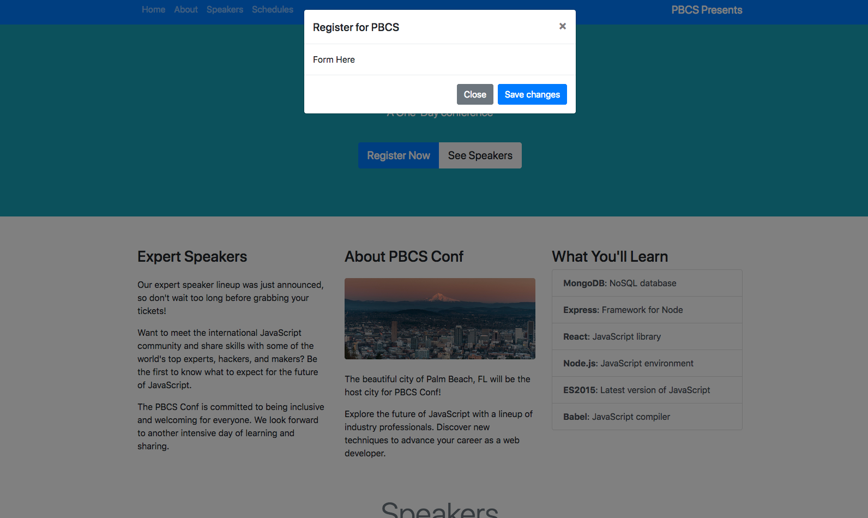
Bootstrap 3

Slide 10
Bootstrap 3
Scrollspy Components
(Included with bootstrap.js library)
https://getbootstrap.com/docs/4.3/components/scrollspy/
Highlight the site’s active navigation link when you scroll in a single page design
Automatically update Bootstrap navigation or list group components based on scroll position to indicate which link is currently active in the viewport.
It must be used on a Bootstrap nav component or list group.
Anchors (<a>) are required and must point to an element with that id.
Uses data-spy="scroll" data-target="#navbar-example"
Must change the data target to match class name
data-offset offsets the value you specify to set when the Scrollspy gets activated

Slide 11
Bootstrap 3
In Class Assignment:
Add data-spy="scroll" data-target="#navbar-example" to the <body> tag of the page just below the </head> tag <body data-spy="scroll" data-target="#.navbar-example">
Change the data-target to .navbar classname must have the period to make it work
Add the id= "home" into the body tag <body id="home" data-spy="scroll" data-target=".navbar"> which matches the #home href in the nav <a class="nav-item nav-link " href="#home">Home <span class="sr-only">(current)</span></a>
Add an id about to the about <section> just below the about section comment tag
<!-- About Row -->
<section id="about" class="row">
Speakers id for that section was added already <h1 class="display-4 text-center my-5 text-muted" id="speakers">Speakers</h1>
Add the id name schedule to the schedules section just below the schedules comment tag and in the <h1>
<h1 id="schedules" class="display-4 text-center text-muted my-5">Schedules</h1>
This will update the color on the navigation when you scroll to the section
Add the utility class data-offset="100" for the value to the <body> tag this sets a space to trigger it above the target section and gives a bit of spacing before the color change on the navbar item
<body id="home" data-spy="scroll" data-target=".navbar" data-offset="100">

Slide 12
Bootstrap 3
Bootstrap Forms
https://getbootstrap.com/docs/4.3/components/forms/
Form Grouping Class form-group Can be used inside a container to group form items and space the elements adding structure to the form. Displays the form vertically
<form>
<div class= "form-group"></div>
</form>
Form Classes are used to identify types of elements form-control is used for text boxes etc.
<input type="tel" class="form-control">
Form Group and Form Control are used most often
Form classes are used to identify types of elements form-control-label is used for labels
<label class="form-control-label" for="formGroupInput"></label> .
form-inline (for inline forms) can be placed in the main <form class="form-inline"> tag to make the form display controls next to each other

Slide 13
Bootstrap 3
Bootstrap Forms
Individual form controls automatically receive some global styling. All textual <input>, <textarea>, and <select> elements with form-control are set to width: 100%; by default. Wrap labels and controls in form-group for optimum spacing.
<form class= "form">
</form>
Form Element Classes <div class="form-row"> removes the spacing / gutters around the form

Slide 14
Bootstrap 3
In Class Assignment:
Remove the modal footer div just before the div <!-- ==========Modals End============= -->
<div class="modal-footer">
<button type="button" class="btn btn-secondary" data-dismiss="modal">Close</button>
<button type="button" class="btn btn-primary">Save changes</button> </div>
Copy the form information from the text for PBCS conf page file and paste it where the Form Goes Here text is located in the modal body <div class="modal-body">
<!-- =====================Form Start============= -->
<!-- =====================Form End============= -->
</div>
Change the for label from formGroupExampleInput to name,and the label Example Label to Name <label for="Name">Name</label>
Change the input id to name <input type="text" class="form-control" id="name">
Do the same for the second form element using email for for="email" label, type and id

Slide 15
Bootstrap 3
In Class Assignment:
Remove the placeholder="Example input" from each input
Add a new <div> with a class form group , a label <label for="job">Job Title</label>, and select form control for job title (you can copy paste).
Add a new div with the class form-group just above the </form> tag <div class="form-group"></div>
Add a label called job <label for="conftype">Job</label>
Add an input inside the new div and make it a <select></select>
Add an id to the select <select id="job"></select> called job
Add two options<option value= " "></option> inside the select with a value and label called Front End Developer and Back End Developer <option value="Front End Developer">"Front End Developer</option>

Slide 16
Bootstrap 3
In Class Assignment:
Create a new form group div below </select></div> tags
Copy the Check Box text from the text for PBCS Conf text file
Paste it inside the new form group div
<div class="form-group">
<div class="form-check">
<input class="form-check-input" type="checkbox" value="" id="defaultCheck1">
<label class="form-check-label" for="defaultCheck1">
Default checkbox
</label>
</div>
<div class="form-check">
<input class="form-check-input" type="checkbox" value="" id="defaultCheck1">
<label class="form-check-label" for="defaultCheck1">
Default checkbox
</label>
</div>
Add the checkbox text from the PBCS Conf File and paste directly below the </select></div>
Modify the checkbox id, text, for and the label’s value on each to be
Javascript
HTML-CSS

Slide 17
Bootstrap 2
In Class Assignment Cont’d:
Directly below <form> Add a heading to the form with an <h5></h5> titled Basic Info: and give it a class margin bottom of mb-4 <h5 class="mb-4">Basic Info</h5>
Add an <hr> divider line directly above the <h5></h5> with a class="my-4
Add a submit button with a class="mt-4 below the </div> and above the </form>
<button type="submit" class="btn btn-primary mt-4">Register</button>

Slide 18
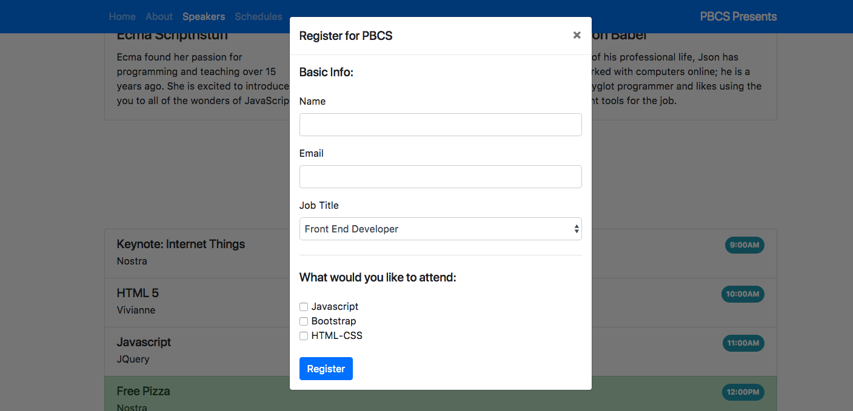
Bootstrap 2

Slide 19
Bootstrap 2
Using a custom CSS file with Bootstrap 4
Create a new stylesheet called custom.css and save it in the css folder in class-samples/css
Add a link to your custom.css style sheet just above the </head> but below the Bootstrap CSS CDN link <link href="css/custom.css" rel="stylesheet" type="text/css" />
Make the navbar brand on the right lighter/smaller by adding .navbar .navbar-brand and a color of rgba(0, 0, 0, 0.85); or black as well as a font size:1rem;
Add a background image jumbo-bg.jpg to the jumbotron by adding the background-image: url(../images/jumbo-bg.jpg); targeting the .jumbotron class in your custom stylesheet use, background-size:cover; to cover or scale the width of the whole width of the jumbotron

Slide 20

Bootstrap 2

Slide 21
Additional Topics

Slide 22
Bootstrap 2
Bootstrap 4 Carousels
The carousel is a slideshow for cycling through a series of content, built with CSS 3D transforms and a bit of JavaScript. It works with a series of images, text, or custom markup. It also includes support for previous/next controls and indicators.
The carousel itself (.carousel) consists of 3 parts:
Order List -carousel-indicators (bullets navigation in the carousel bottom),
carousel-inner (in which we will place the content to be presented)
carousel-control (left and right arrow).
Images should be the same size or set to cover the carousel.
http://getbootstrap.com/docs/4.3/components/carousel/
https://bootstrapious.com/p/bootstrap-carousel

Slide 23
Bootstrap 2
Bootstrap 4 Carousels
Open the carousel-student.html page save it to public_html/class-samples
Add the carousel text from the PBCS text for pbcs file and paste it into the container div
Replace the carousel items with the chi.jpg, germ.jpg , and nyc.jpg photos in the images folder
<div class="carousel-item active">
<img class="d-block w-100" src="images/chi.jpg" alt="First slide">
</div>
Try Adding another image carousel item (sea.jpg) to the carousel
<div class="carousel-item">
<img class="d-block w-100" src="Your Image 3" alt="Third slide">
</div>
You will also have to add another list item to the ordered list for the carousel to work
<li data-target="#carouselExampleIndicators" data-slide-to="3"></li>

Slide 24
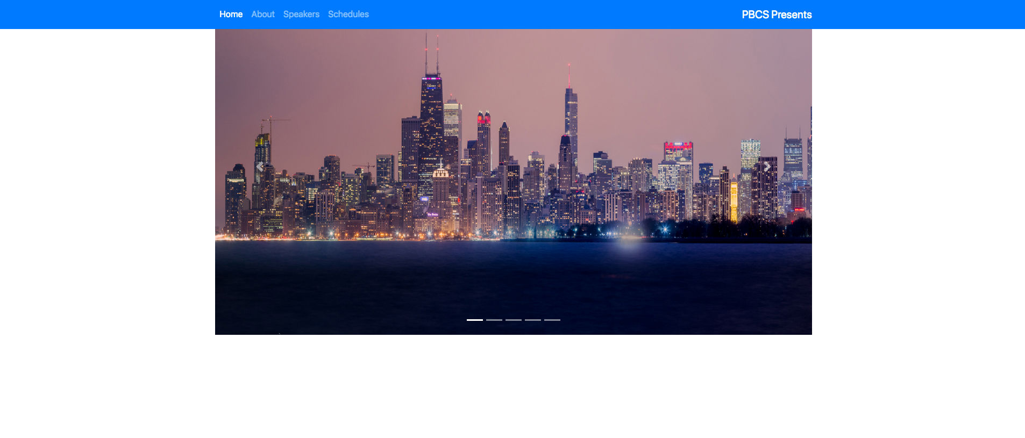
Bootstrap 2

Slide 25
Bootstrap 2
Homework
Next Slide-PBCS Project
Complete a single page design of the PBCS website including a modal, carousel and using a custom stylesheet
Complete https://teamtreehouse.com/library/framework-basics
Resources: https://startbootstrap.com/template-categories/all/

Slide 26
Bootstrap 2
Create the PBCS site using Bootstrap 4 and a Custom CSS file
Create an index.html page and save it in the public_html/class-projects/bootstrap folder
Create a css folder and save the custom.css file in the public_html/class-projects/bootstrap/css folder
Create an images folder and save the images in the public_html/class-projects/bootstrap/images folder
Images and text will be sent to you
Site will be demonstrated to class by the instructor

Slide 27
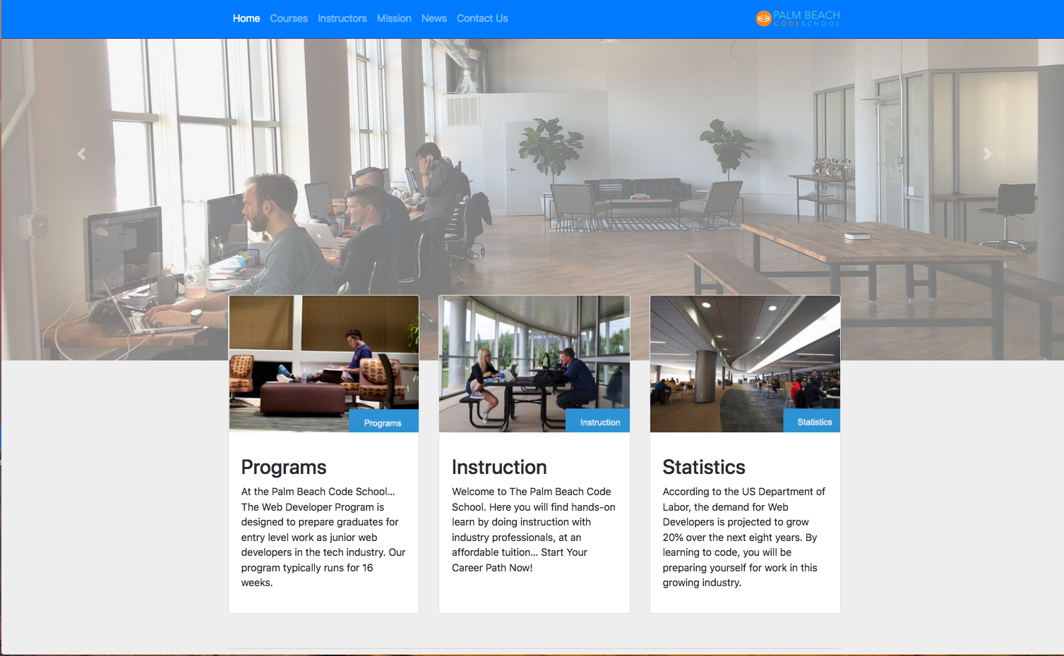
Bootstrap 2

Slide 28
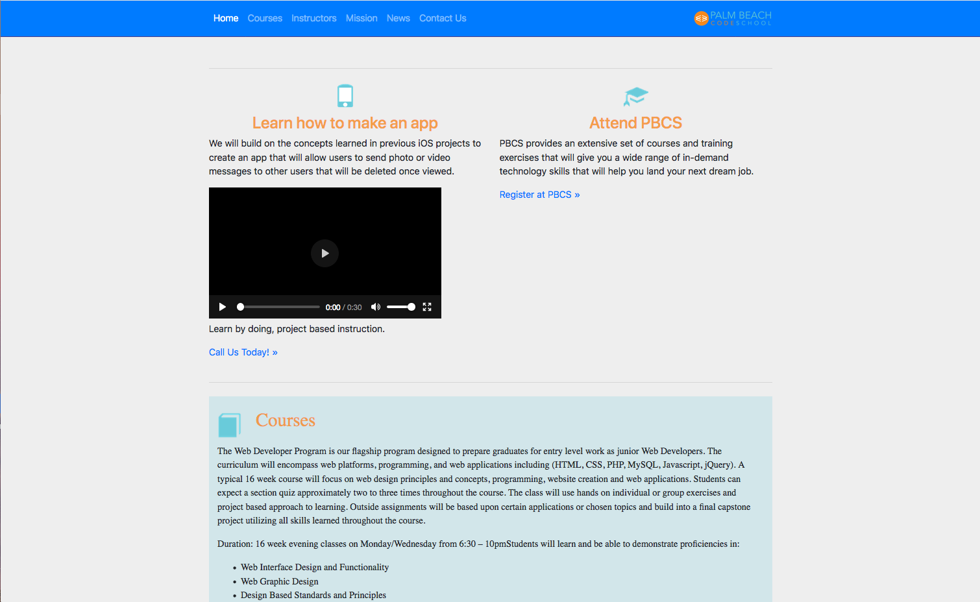
Bootstrap 2

Slide 29
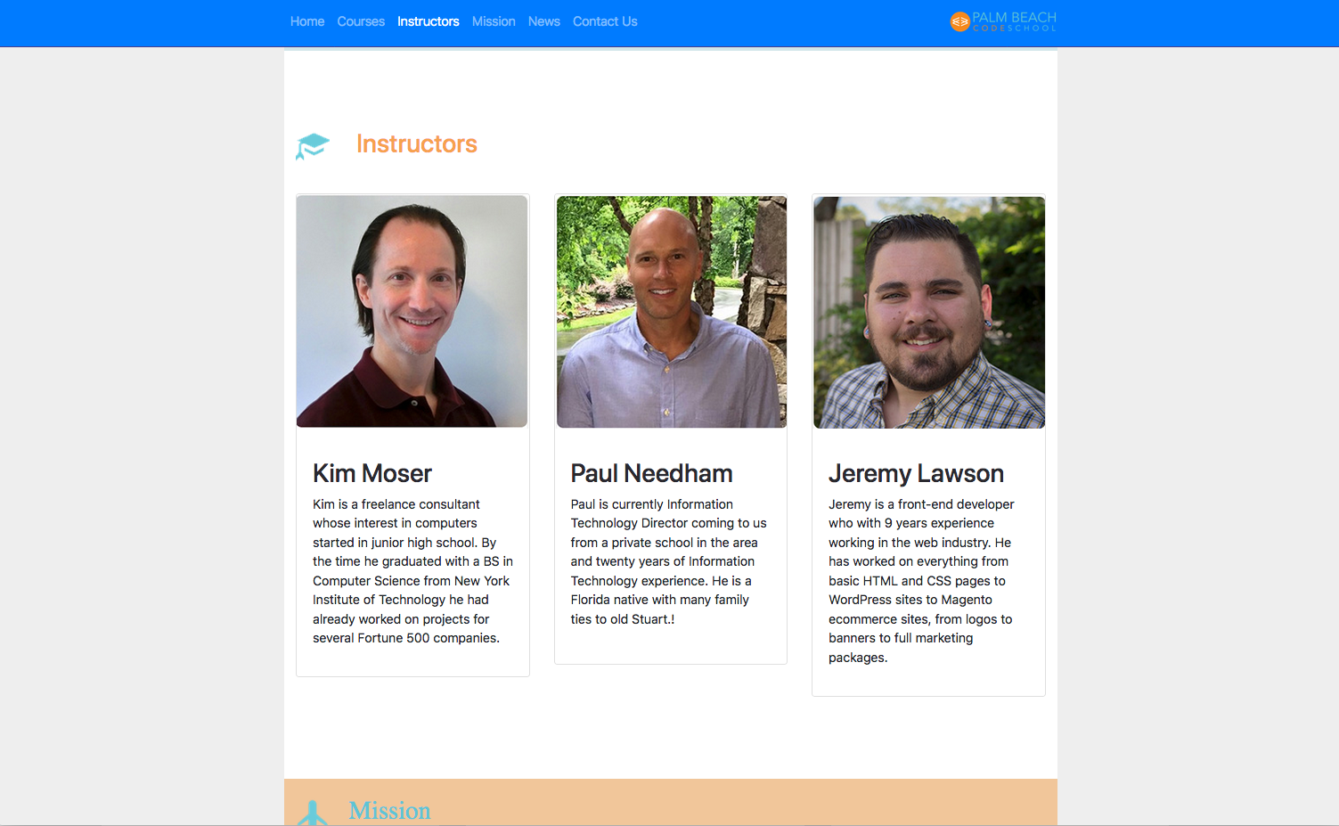
Bootstrap 2

Slide 30
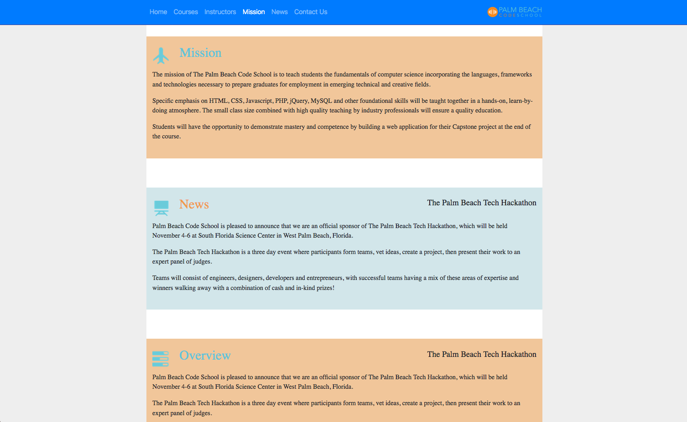
Bootstrap 2

Slide 31
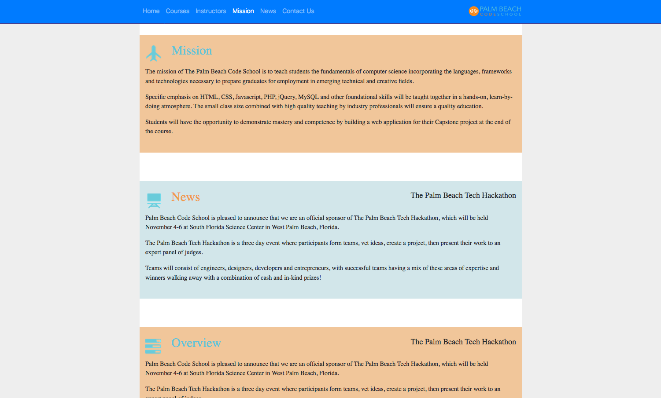
Bootstrap 2

Slide 32
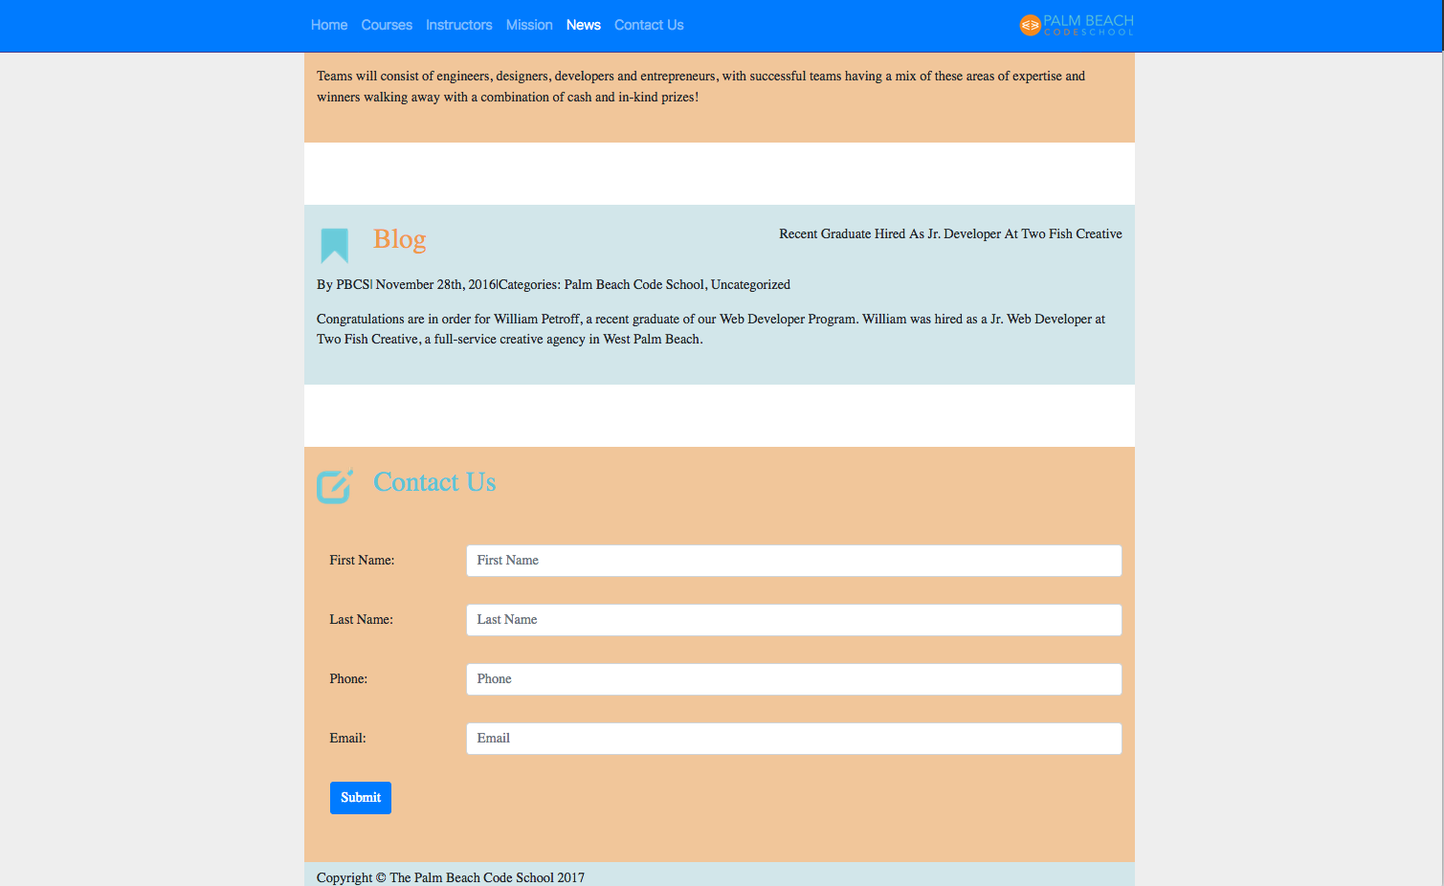
Bootstrap 2

